Slide 1

Assessing Access to Old-Growth Forests in the US South Using FIA Data
Chris Mihiar
Research Economist Forest Economics and Policy
Anna Overby
2024 FIA Science Symposium
Research Forester Forest Economics and Policy
November 20, 2024

Slide 2
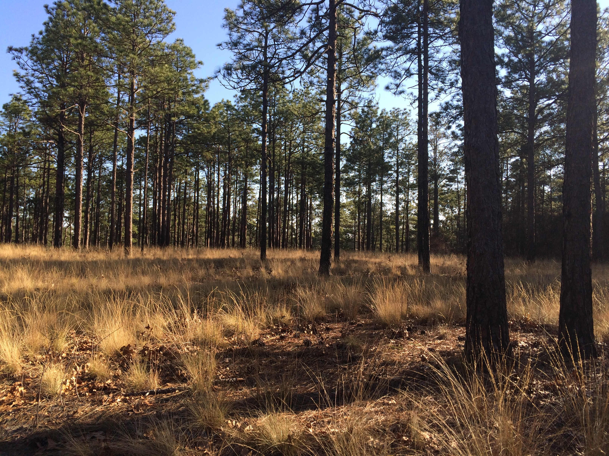

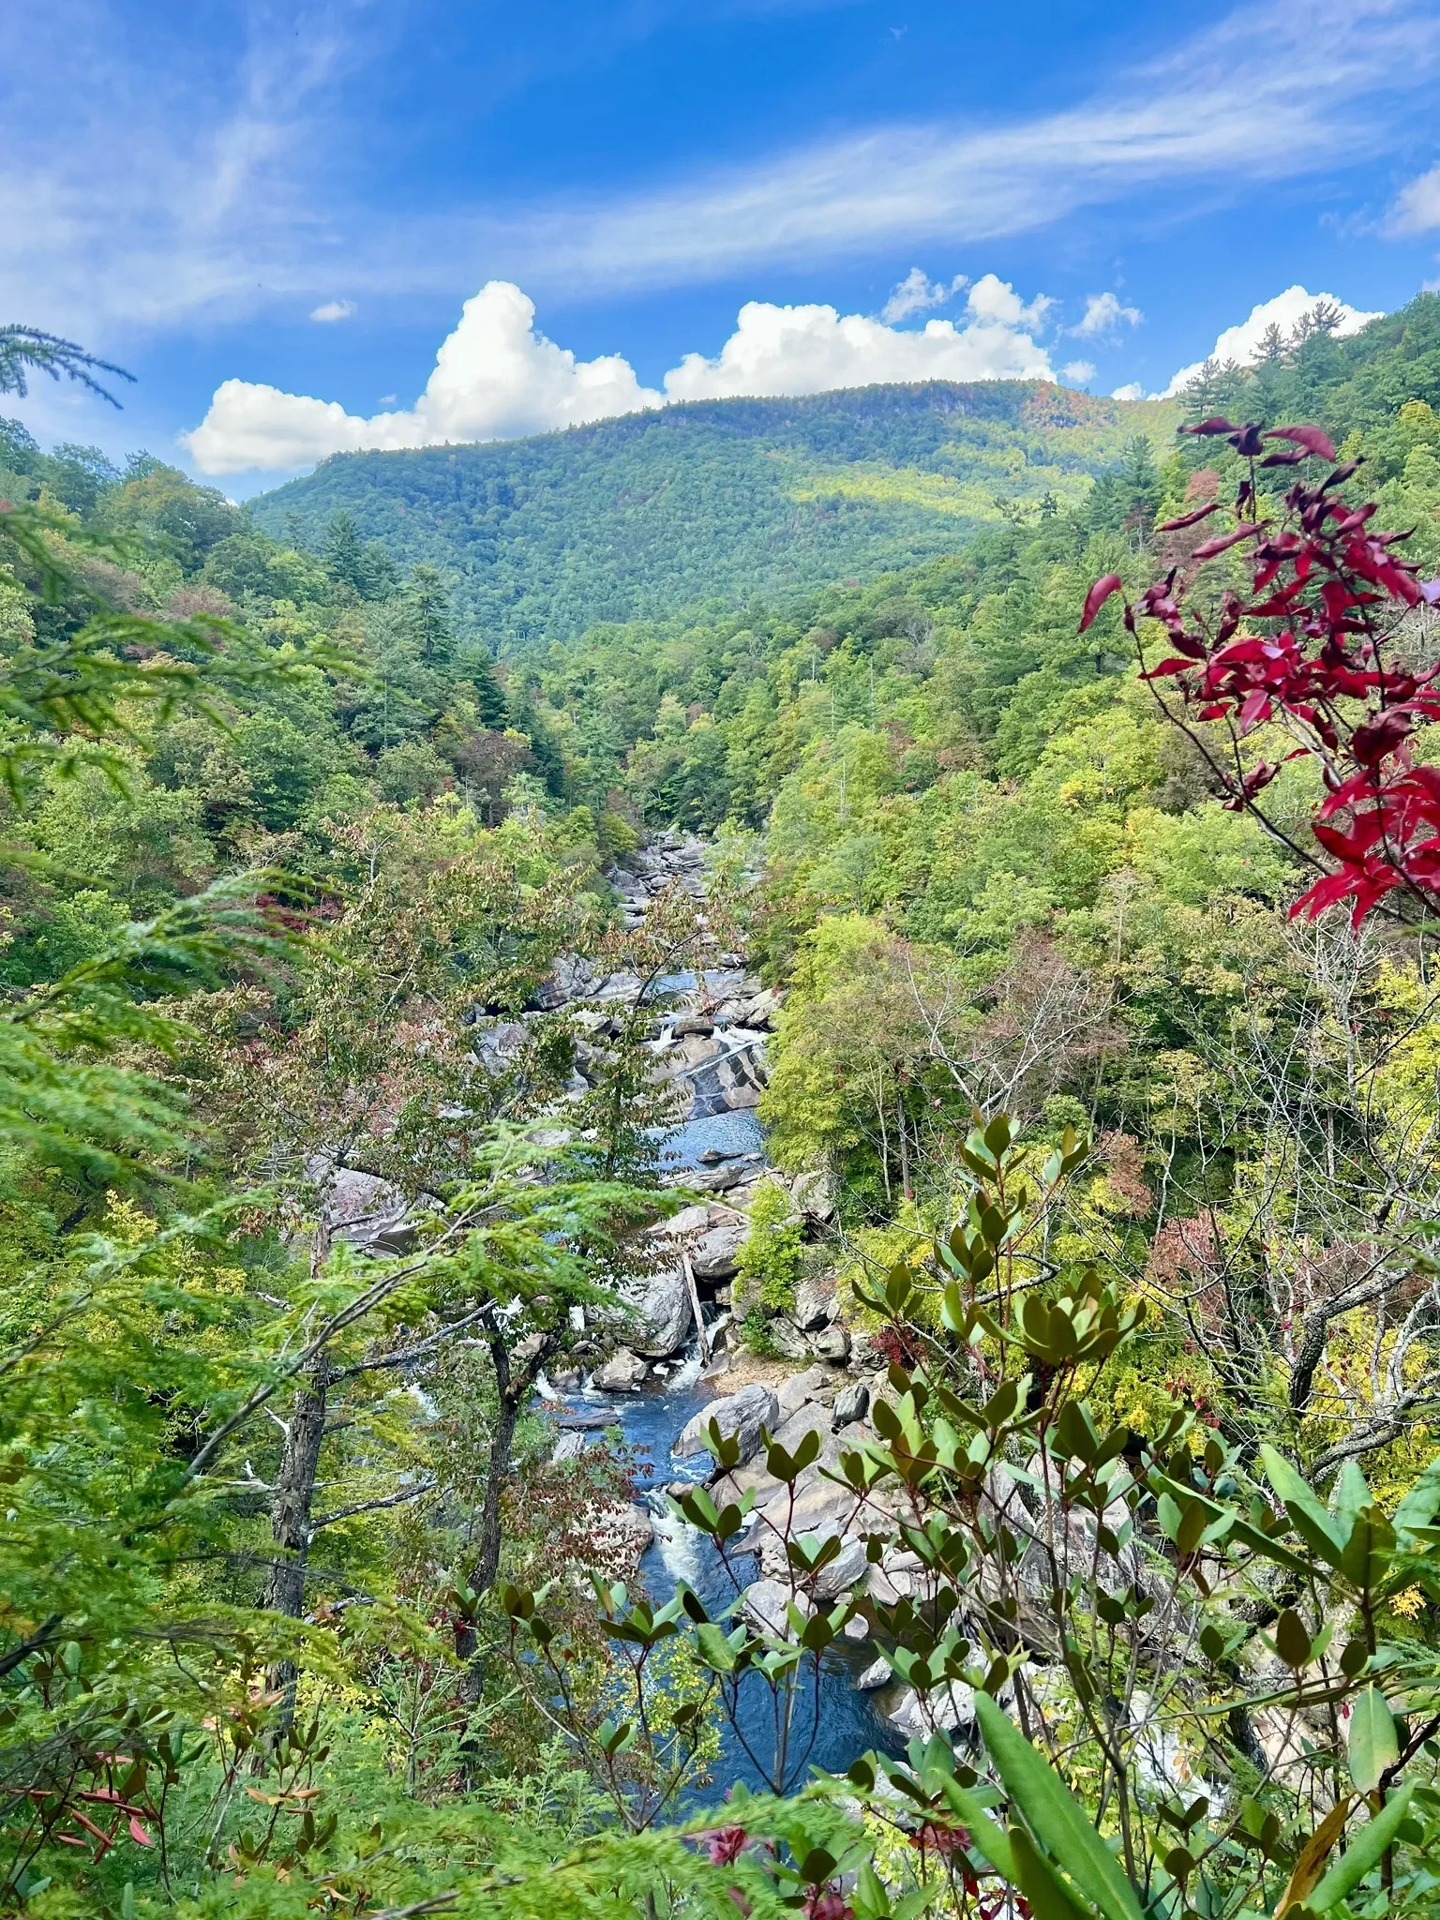
Significant Life Experiences Framework
Outdoor experiences activate our biophilia-based bond with nature (Louv, 2006; Orr, 2004; Pyle 1998; Sobel, 1996).
Outdoor experiences during youth are a common critical experience of individuals who choose careers in conservation (Chawla, 1988).
91% cited experiences in outdoors as source of environmental attitudes
45% cited studies of natural systems as source of environmental attitudes
When asked to identify source of commitment to environmental protection
77% cited experiences in nature
38% cited education
USDA Forest Service

Slide 3
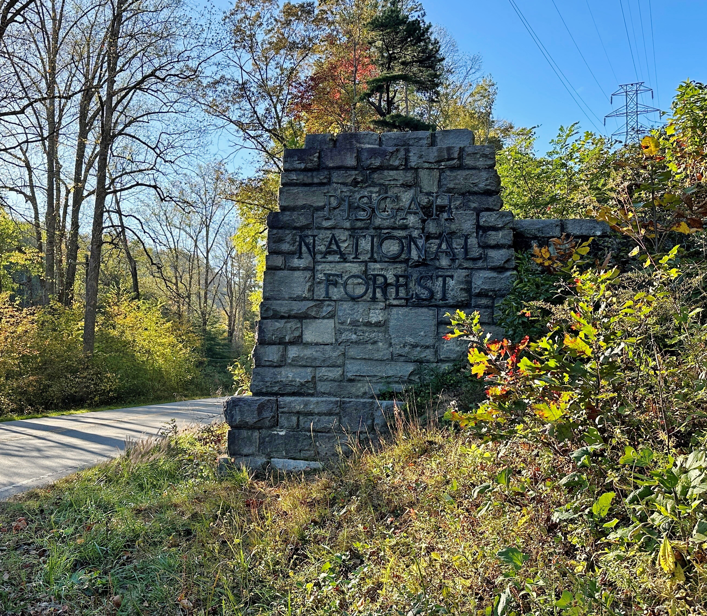
Nature Access Initiatives
Linking public transit to natural area (e.g., Transit-to-Parks -- T2P)
Congestion
Environmental Concerns
Equity
Economic Development
Limited research from this perspective that’s specific to old-growth
The wicked problem of defining and inventorying mature and old-growth forests (Gray et al. 2023)

Slide 4
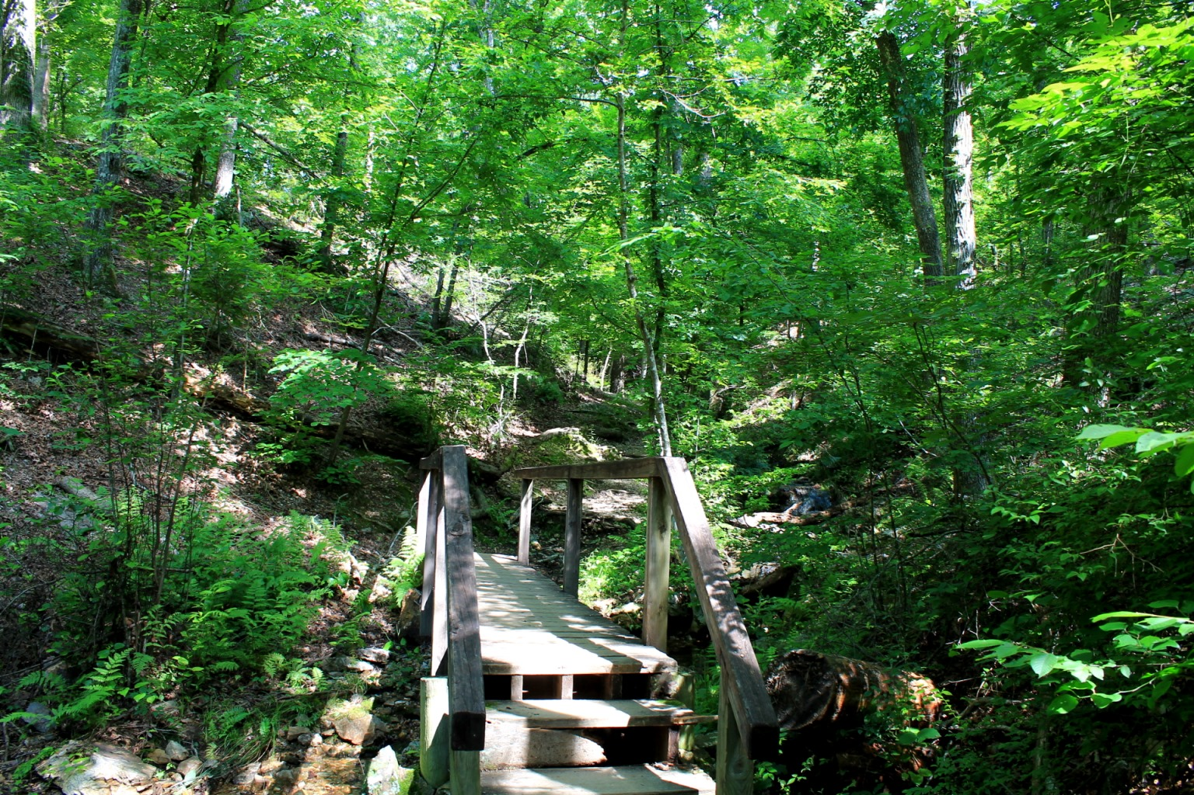
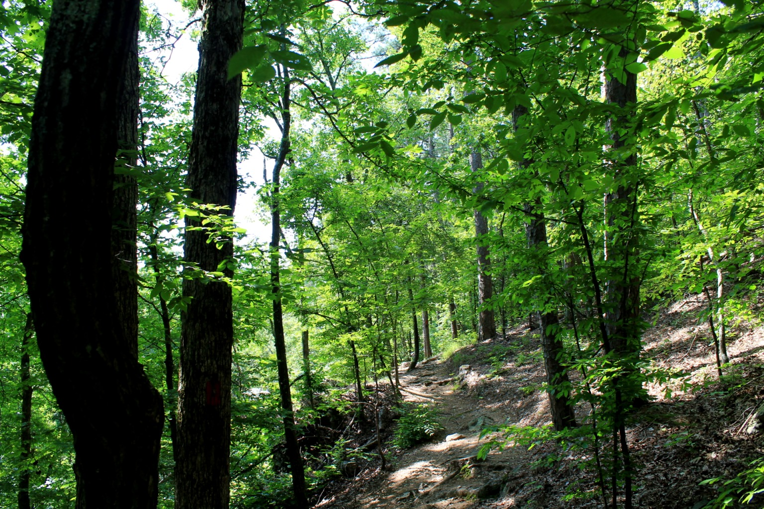
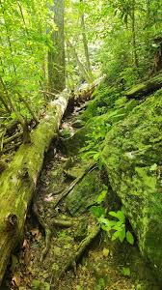
Research Approach
Motivating Questions
What are public old-growth forests like?
Where are they?
How do people access them?
How many people have “easy” access?
Do we have the data?
Tree data (FIA)
People data (Census)
Points of interest
Hiking trails (NFS)
Roads (OpenStreetMap)

Slide 5
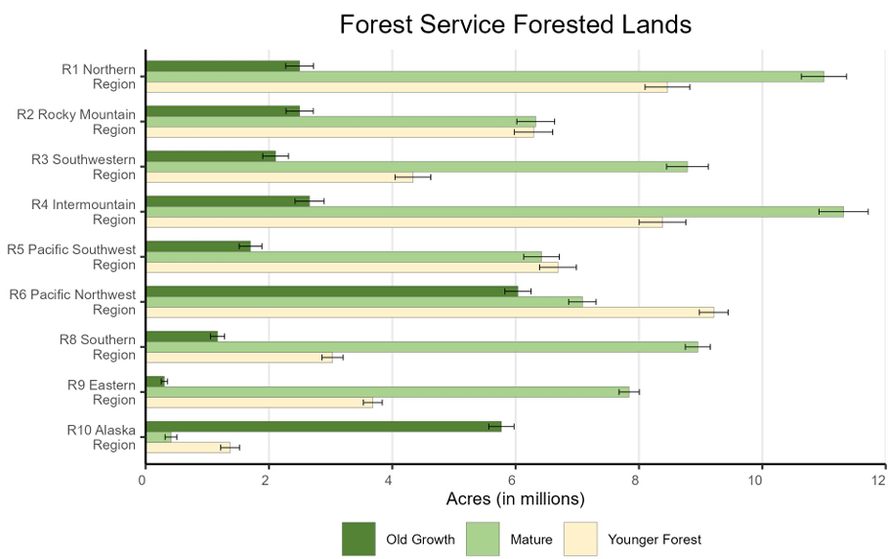
~ 6 million acres
~ 1.2 million acres

Slide 6
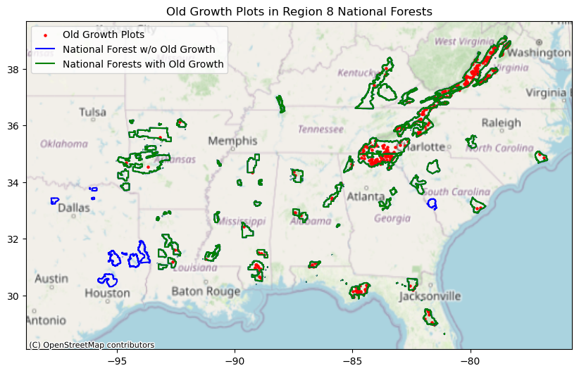
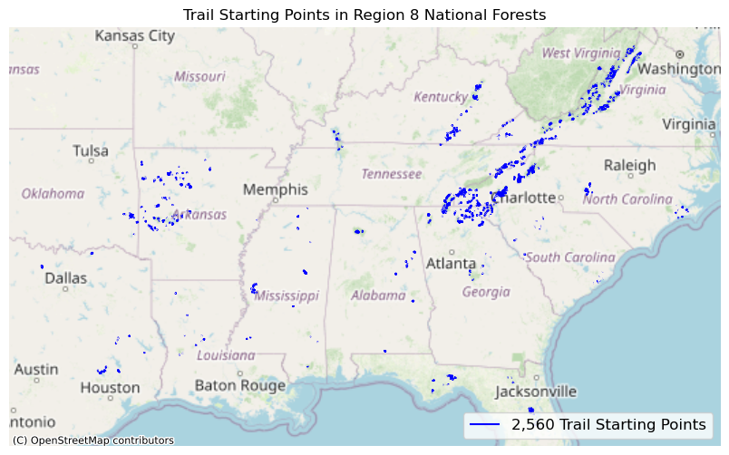
Where is old-growth forest in the South?
Its mostly concentrated in the Appalachian region, but we see some in other National Forests too. (But not all.)
How can people access
old-growth forest?
National Forest System Hiking Trails provide access to these forests.

Slide 7
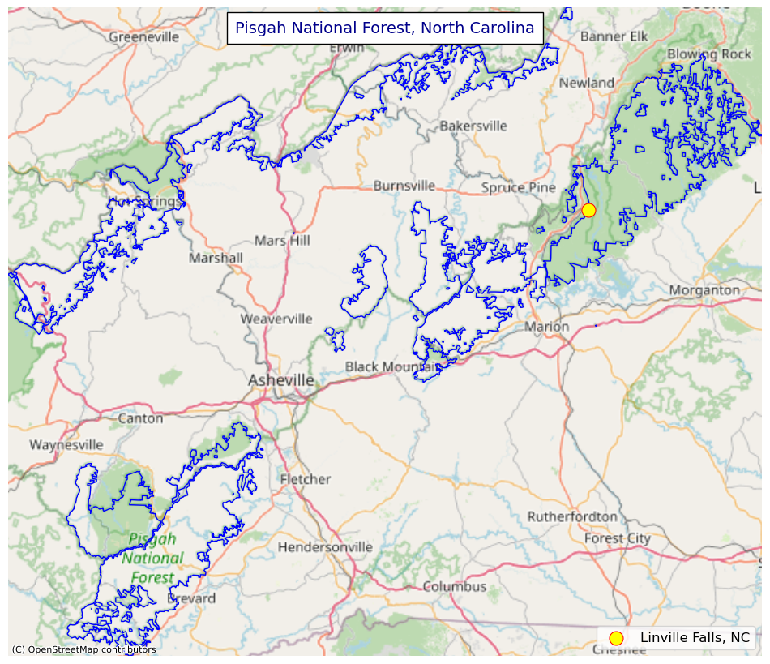
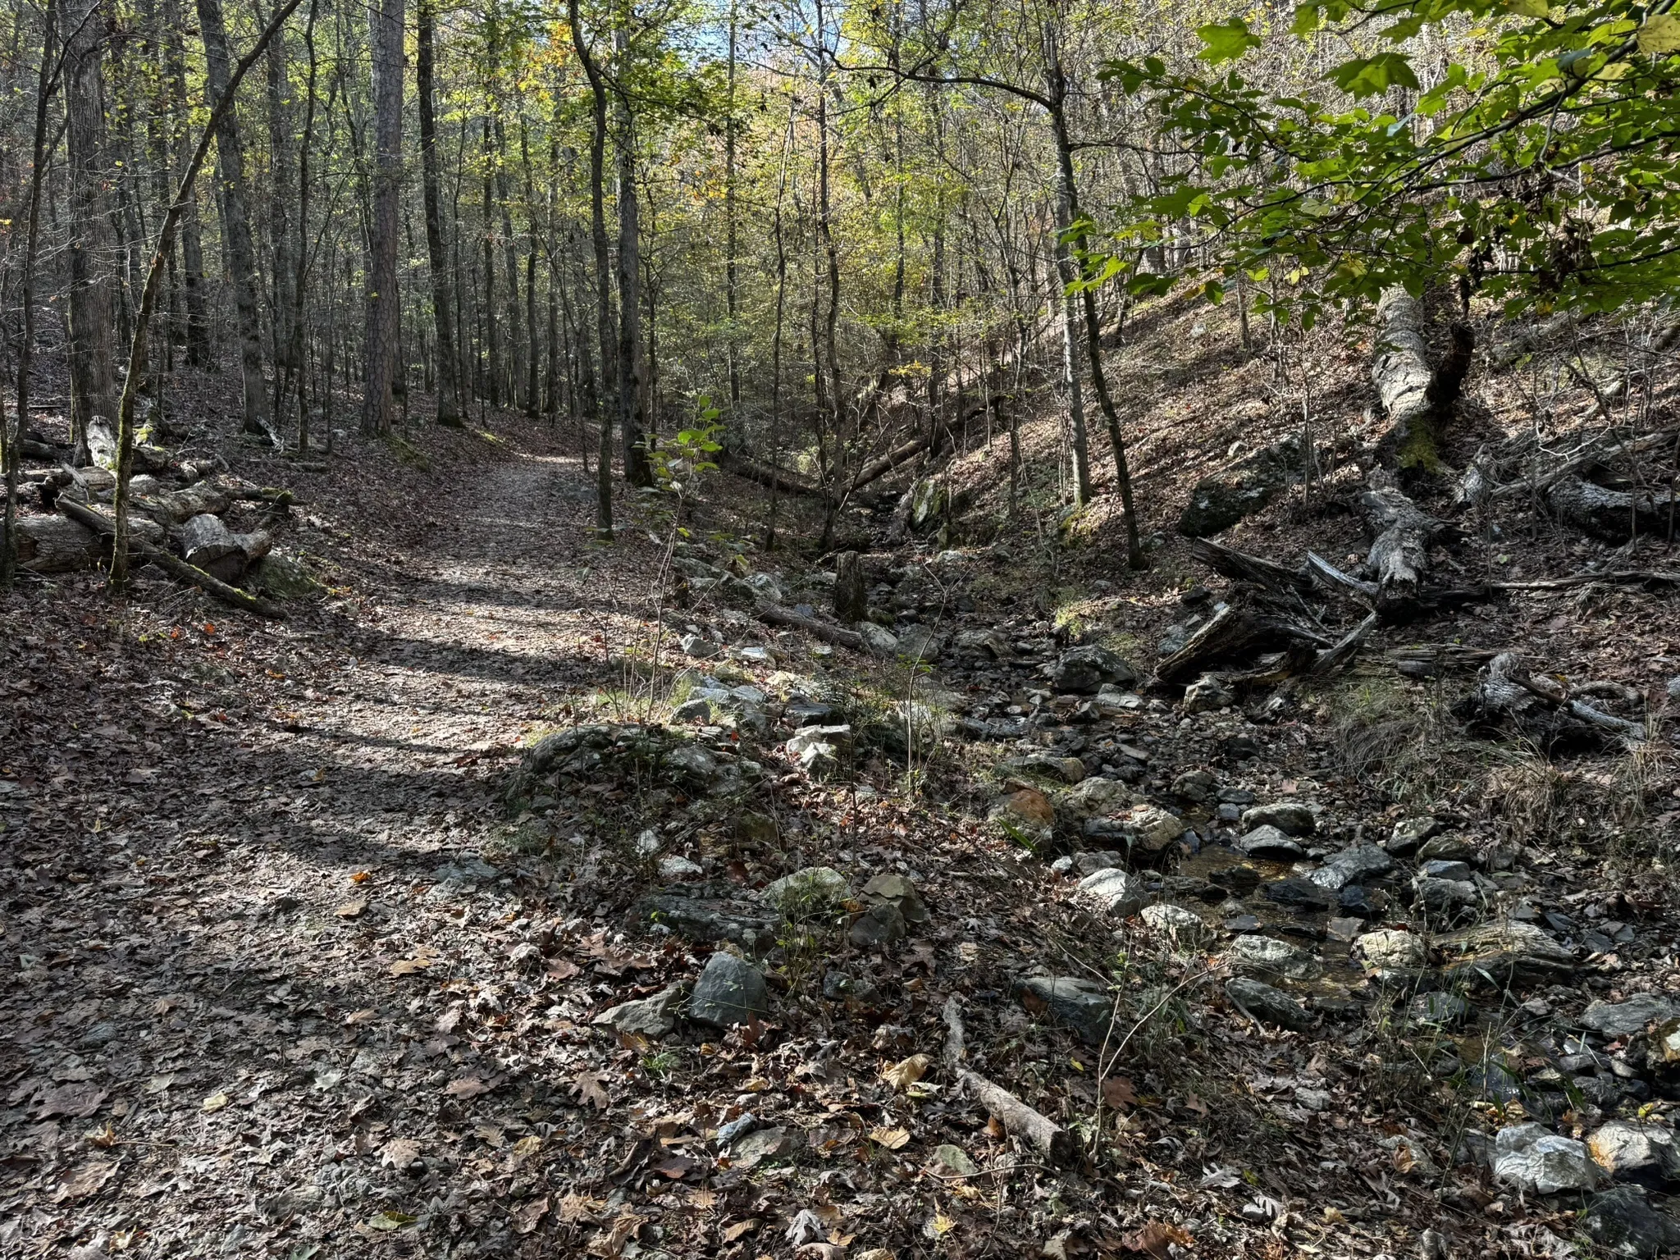
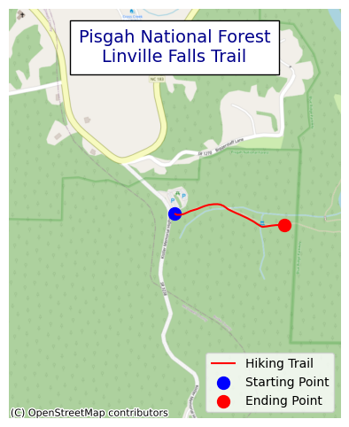
Locating the hiking trails (1min)
Let’s look at an example.

Slide 8
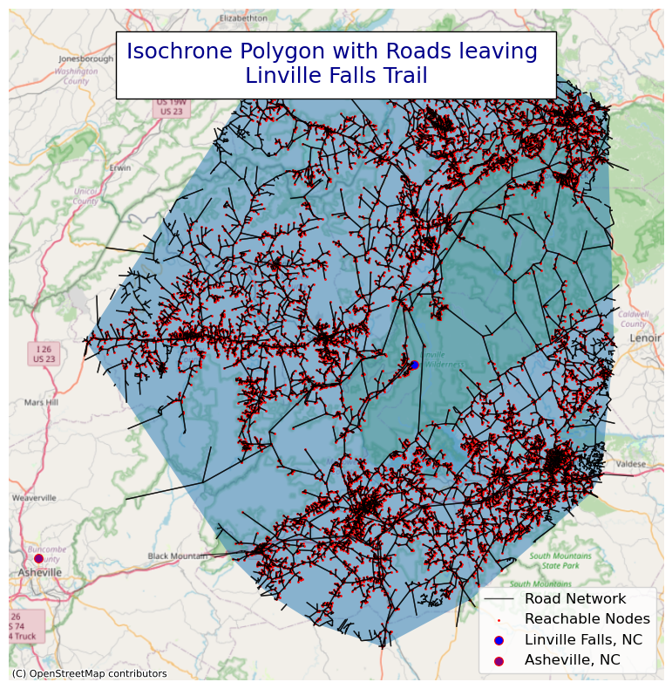
Who can ‘easily’ drive to this old-growth trail?
An isochrone polygon shows the areas reachable within a specific travel time
OpenStreetMap uses detailed geospatial data and routing algorithms to calculate travel time
Road types
Speed limits / average speed
Mode of transport
Python libraries
OSMNX and/or requests
Holcombe Falls

Slide 9
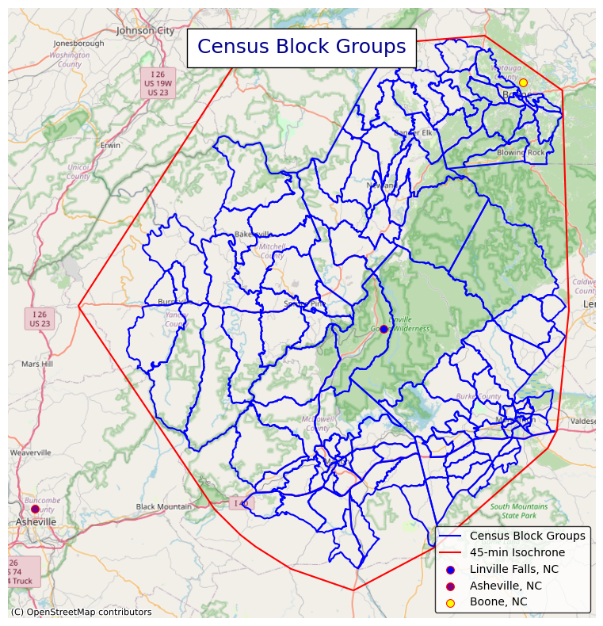
Who lives within driving distance of Linville Falls Trail?
Combine U.S. Census data with isochrones to characterize nearby communities
American Community Survey (ACS)
Detailed demographic, social, economic, and housing data
Decennial Census
Comprehensive counts and basic demographics
Public Use Microdata Survey
Harmonized microdata from surveys like the ACS

Slide 10
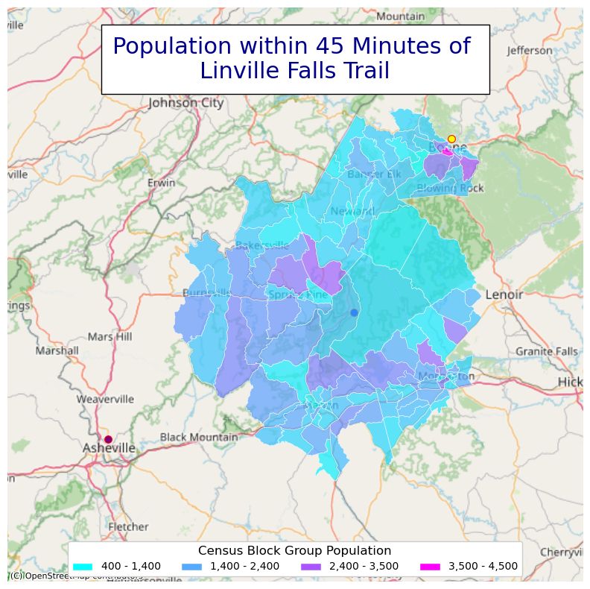
We can look explore a range of demographics
Age, gender, race, ethnicity
Income, employment, poverty
Educational attainment and school enrollment
Homeownership and housing costs
Transportation modes available and work locations
Household size, marital status, and family composition

Slide 11
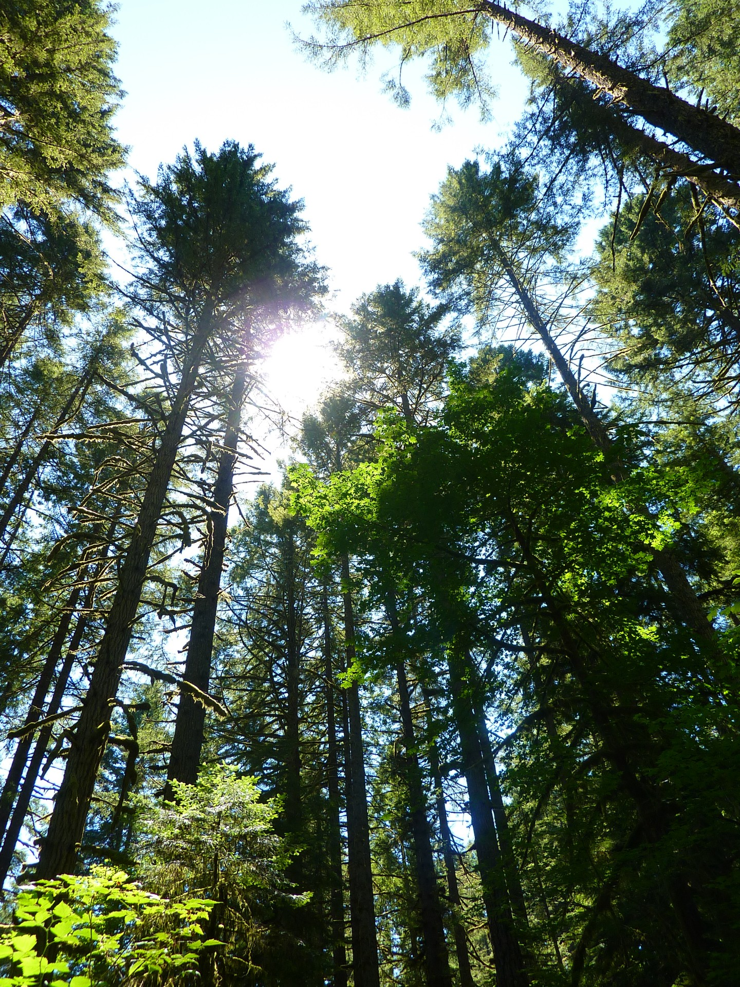
What’s next?
Incorporate FIA NFI estimated old-growth characteristics to identify points of interest
Explore the demographics of nearby communities
Use a qualitative approach to study:
Who goes to these forests? (who doesn’t?)
How does visiting old-growth forests affect knowledge and care for these resources?
Data Sources
github.com/mihiarc/nfs-econ-research/notebooks/mog-south-catchment-areas.ipynb
National Forest Trails -- https://data.fs.usda.gov/geodata/
OpenStreetMap -- https://www.openstreetmap.org
US Census ACS -- https://www.census.gov/programs-surveys/acs

